Slide 1
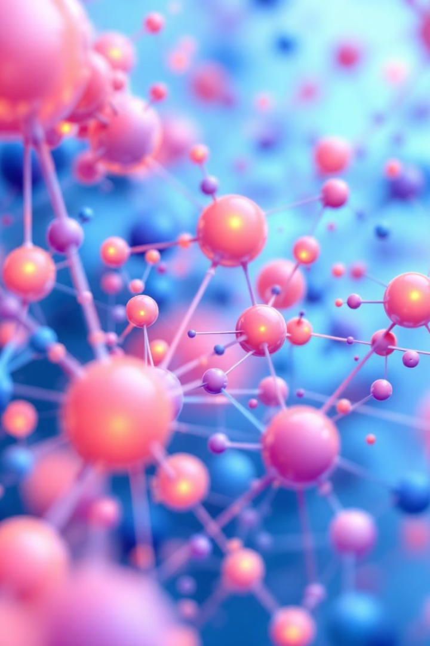
LightRAG: Enhancing Large Language Models with Graph-Based Knowledge
Chethan Madhugiri Chandrashekar Bhagyashri Pagar Divyateja

Slide 2
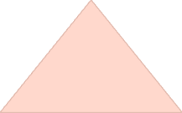






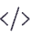
Theoretical Foundation of RAG Systems
LightRAG Approach
Graph-based indexing with dual-level retrieval
Graph-Based Knowledge
Capturing entity relationships and dependencies
Traditional RAG Limitations
Flat documents, poor integration, inefficient retrieval
RAG Mathematical Framework
M = (G, R = (φ, ψ)), M(q; D) = G(q, ψ(q; D ̂ )), D ̂ = φ(D)
Retrieval-Augmented Generation represents a significant advancement in natural language processing by combining information retrieval with text generation. The mathematical framework established by Lewis et al. (2020) provides clear separation between retrieval and generation components.
Traditional RAG approaches suffer from treating documents as independent chunks, struggling to synthesize information across multiple sources, employing computationally expensive retrieval, and inefficiently handling new information. Graph structures have emerged as a powerful solution for representing complex relationships in knowledge.

Slide 3



Core LightRAG Architecture
Graph-Based Text Indexing
Converts document collections into a structured knowledge graph
Dual-Level Retrieval System
Retrieves relevant information based on user queries
Response Generation
Synthesizes retrieved information into coherent answers
Our implementation of LightRAG follows the architecture described by Guo et al. (2024) while adapting it to operate efficiently on standard computing resources. We utilized the official implementation from GitHub, establishing an isolated Python environment with necessary dependencies including sentence-transformers and Google's Generative AI.
The system processes documents by segmenting them into manageable chunks, extracting entities and relationships using LLM-based techniques, and constructing a knowledge graph with vector embeddings for efficient retrieval. Our implementation enables incremental updates without rebuilding the entire knowledge base.

Slide 4
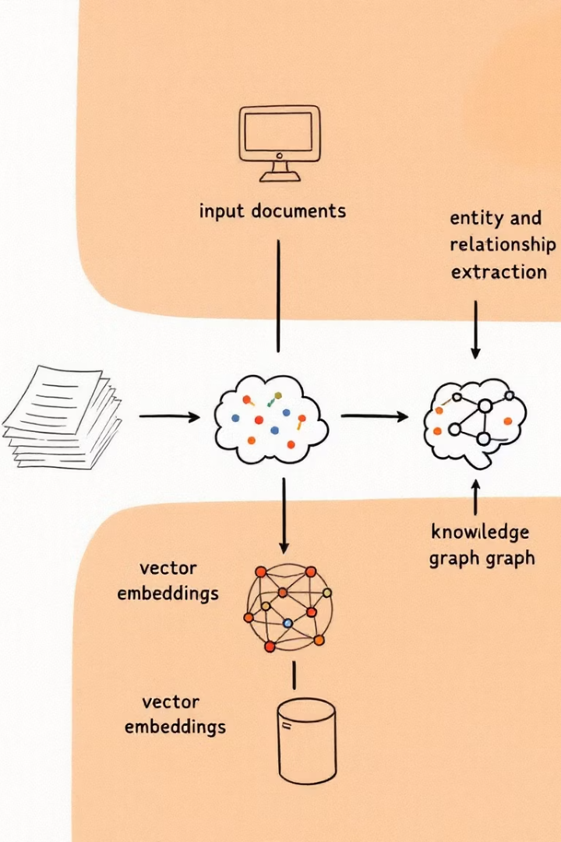
Graph-Based Text Indexing Process
Document Preprocessing and Chunking
Documents are segmented into manageable chunks (1200 tokens per chunk), preprocessed to normalize formatting, and prepared for entity extraction.
Entity and Relationship Extraction
LLM-based extraction identifies and categorizes entities (person, organization, location, event) and determines relationships between them, including directional attributes.
Knowledge Graph Construction
An efficient in-memory graph structure is built with entity deduplication and key-value pair generation using LLM-based profiling.
Vector Embeddings Integration
SentenceTransformer generates embeddings for entity names, descriptions, and relationships, stored in a vector database linked to the graph structure.

Slide 5
Dual-Level Retrieval System
Query Analysis
Low-Level Retrieval
High-Level Retrieval
Extracts high-level (conceptual) and low-level (entity-specific) keywords from user queries, classifies query intent, and converts keywords into vector representations.
Focuses on specific entities and their immediate relationships in the knowledge graph.
Addresses broader conceptual aspects of queries through multi-hop exploration.
Entity matching
Conceptual matching
Relationship traversal
Multi-hop traversal
Keyword extraction
Attribute collection
Theme extraction
Query classification
Query vectorization
The retrieval system integrates results from both levels by merging entity and relationship information, ranking based on relevance to the query, and organizing retrieved information into a structured format for the generation component.

Slide 6

Enhanced Implementation Features
Priority-Based Incremental Update
Calculates node importance based on centrality metrics, access frequency, and recency. Prioritizes high-importance nodes connected to new information and applies intelligent pruning to maintain balance between graph size and coverage.
Query Refinement Module
Detects ambiguities in queries, decomposes complex queries into component sub-queries while maintaining context, and classifies queries based on underlying intent to tailor retrieval strategy.
Domain-Specific Adaptation
Allows definition of custom entity types, specialized relationship types with domain-specific semantics, and integration with existing domain ontologies to leverage specialized knowledge.
Visualization Components
Provides interactive visualization of the knowledge graph structure and retrieval process, showing entity relationships, cluster detection, and path tracing during information retrieval.

Slide 7
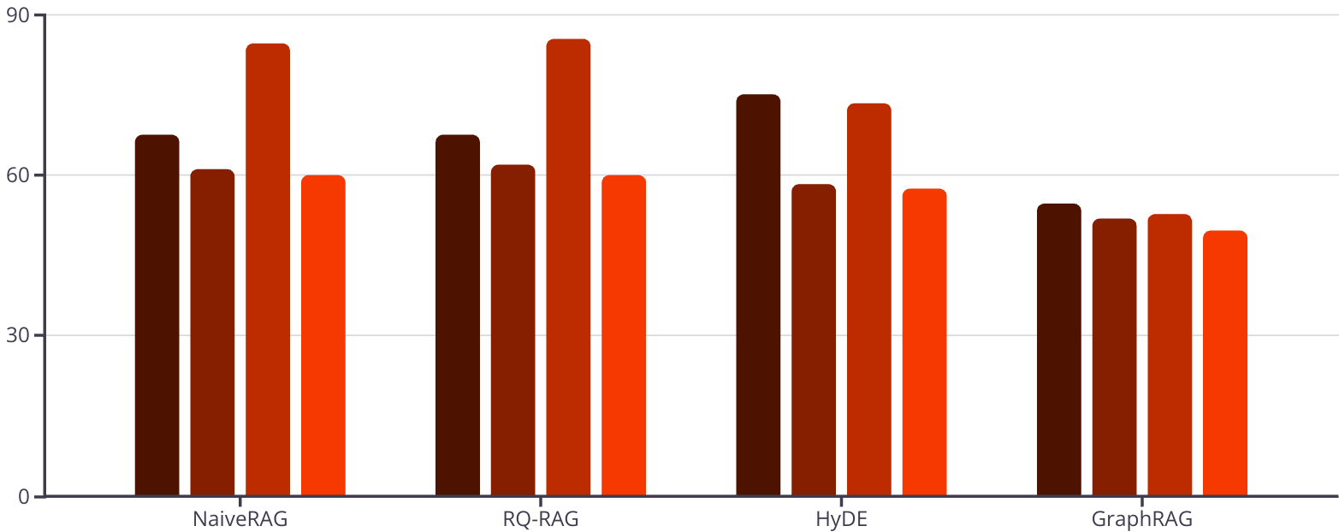
Experimental Results
Agriculture
CS
Legal
Mix

Slide 8



Conclusion and Future Directions
Future Work
Current Achievements
Multi-modal integration, temporal knowledge representation, cross-lingual capabilities, personalized retrieval, and explainable retrieval mechanisms.
Successfully implemented LightRAG with significant enhancements and demonstrated superior performance over existing approaches.
Limitations
Dependency on language model quality, domain generalization challenges, scalability limits with extremely large knowledge bases.
Our implementation and enhancement of LightRAG demonstrates the significant potential of graph-based approaches for retrieval-augmented generation. By representing knowledge as an interconnected graph rather than isolated chunks, LightRAG achieves superior performance in terms of response quality, computational efficiency, and adaptability to new information.
As language models continue to evolve, approaches like LightRAG that effectively ground them in structured knowledge will become increasingly important for ensuring accurate, contextually relevant, and comprehensive responses across diverse applications and specialized domains.

